Slide 1
The Ramifications of Urban Heat on Public Transportation Users
Made Possible by Safia Bamba & Gray Ratcliff

Slide 2
The Problem
We’re currently facing rising temperatures around North Carolina, high enough to cause heat exhaustion and stroke in citizens.
Citizens who ride public transit, having to wait outside for their bus (as well as walking to and from the bus station), are at a further risk of high urban heat exposure.
Studies show that those who are poor, 65 years old or older, overweight, have heart disease, or regularly consume high volumes of alcohol, are more likely to experience heat stroke.
There is, unfortunately a lot of overlap where those outside in these hot temperatures and humid climate, are prone to succumbing to heat exhaustion or stroke.

Slide 3
Public Transportation Use Patterns
43% of people riding public transportation are poor (based a Wake County living wage of $19.23)
Survey on mode of transport to bus stop → 72% of respondents walked
Notes:
Add to the end; What we’re trying to accomplish here are ways for low-income, at risk groups

Slide 4
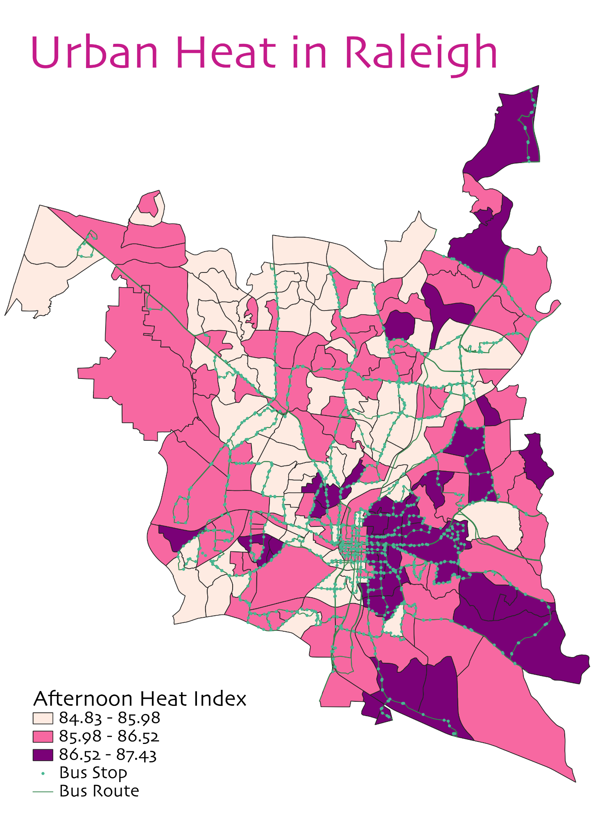
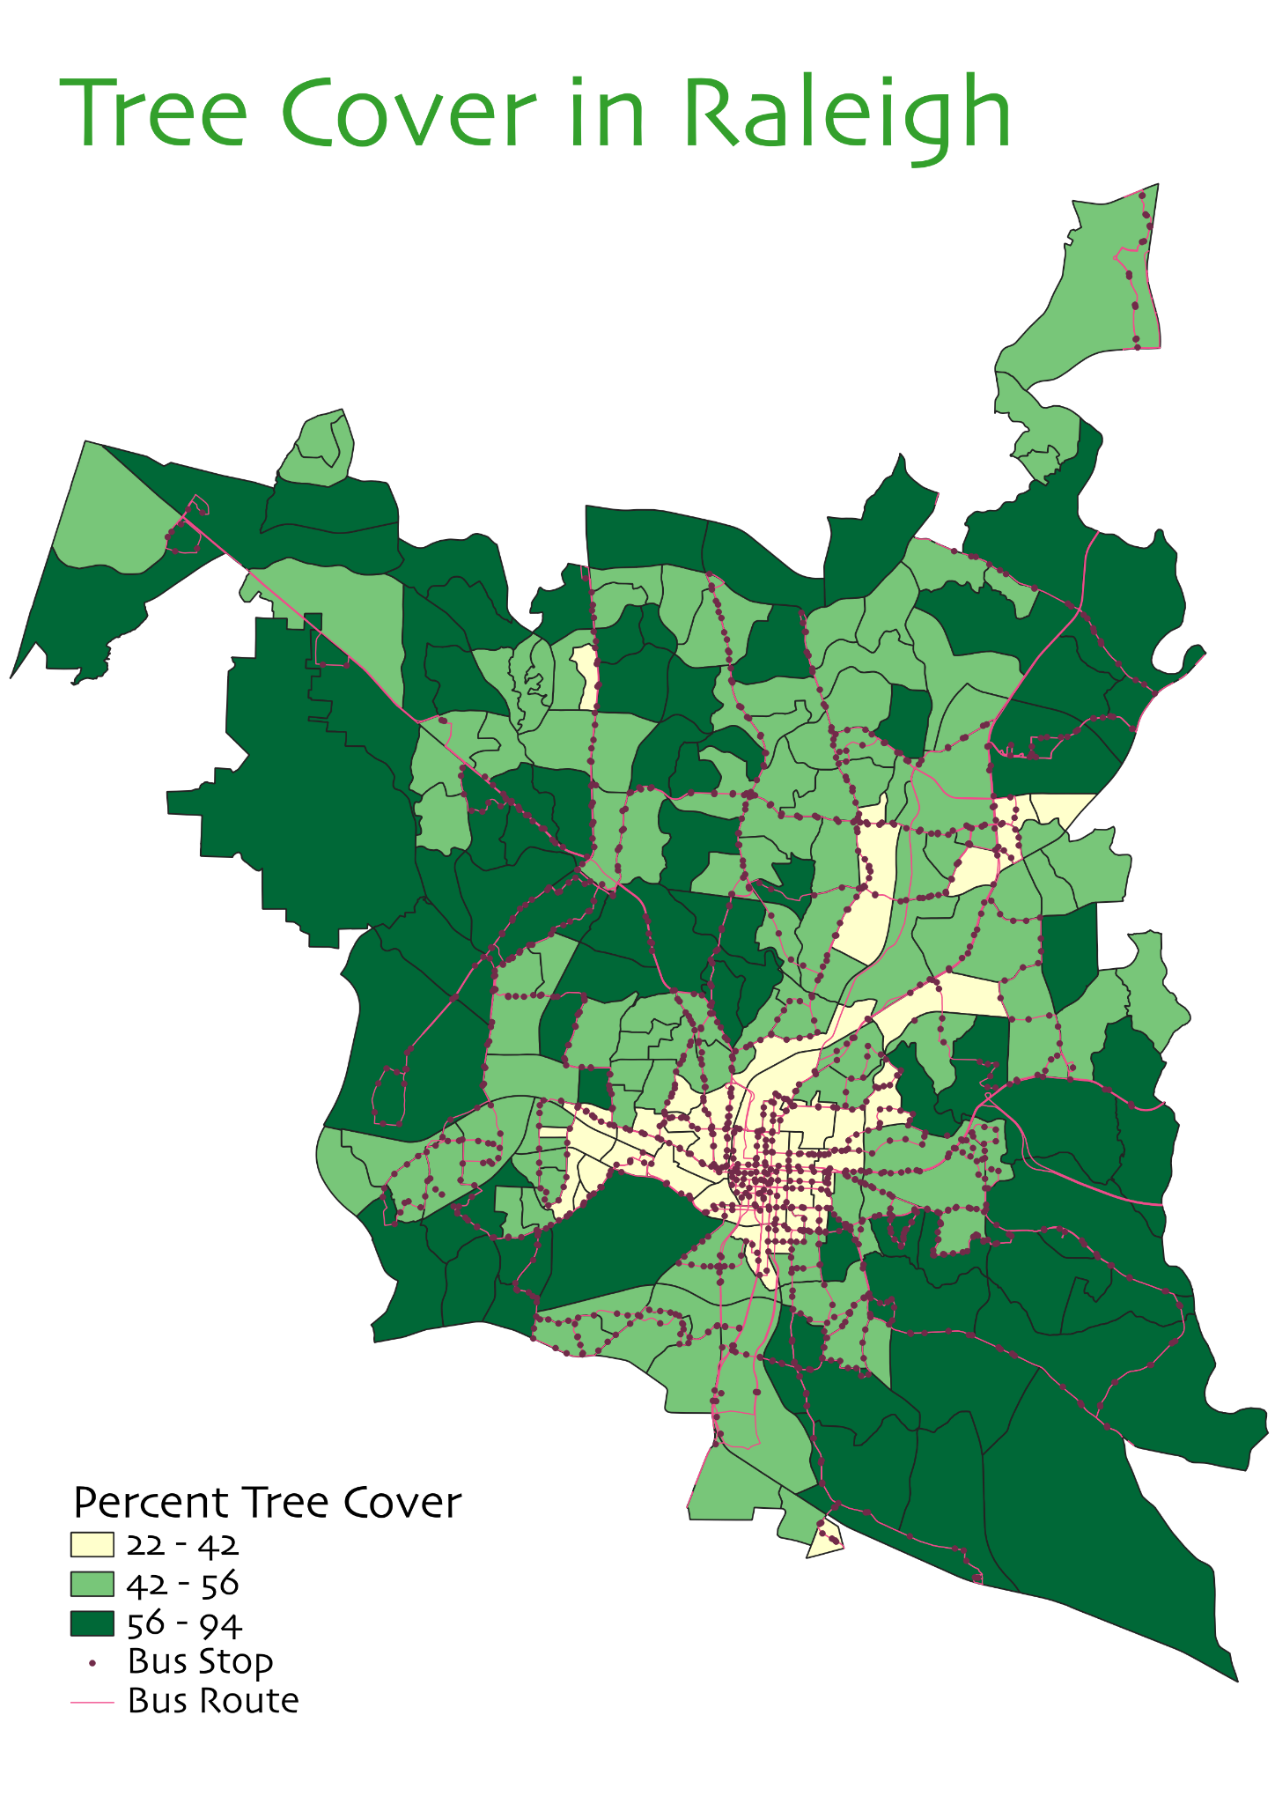

Slide 5
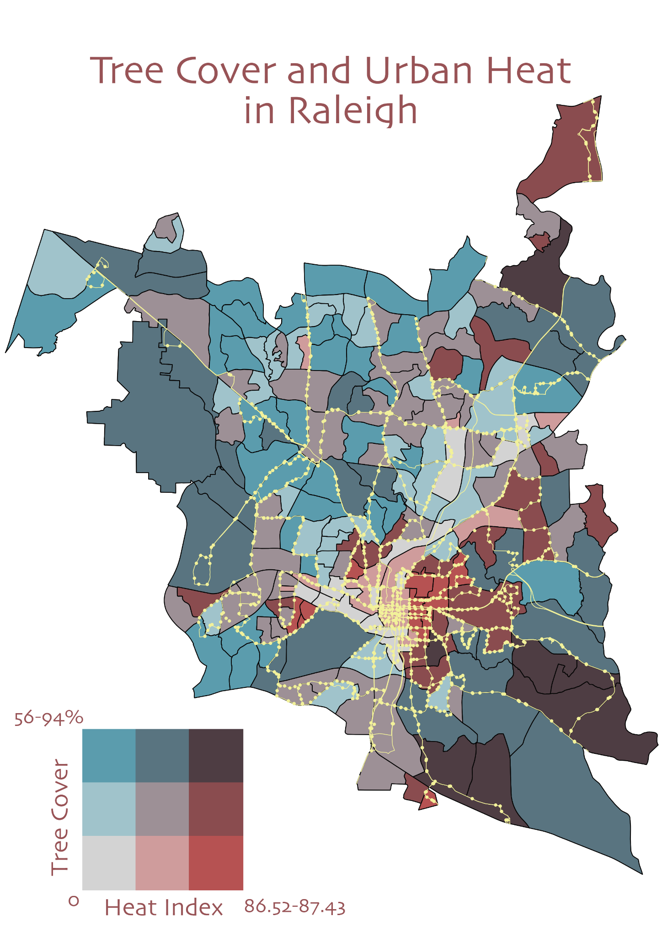

Slide 6
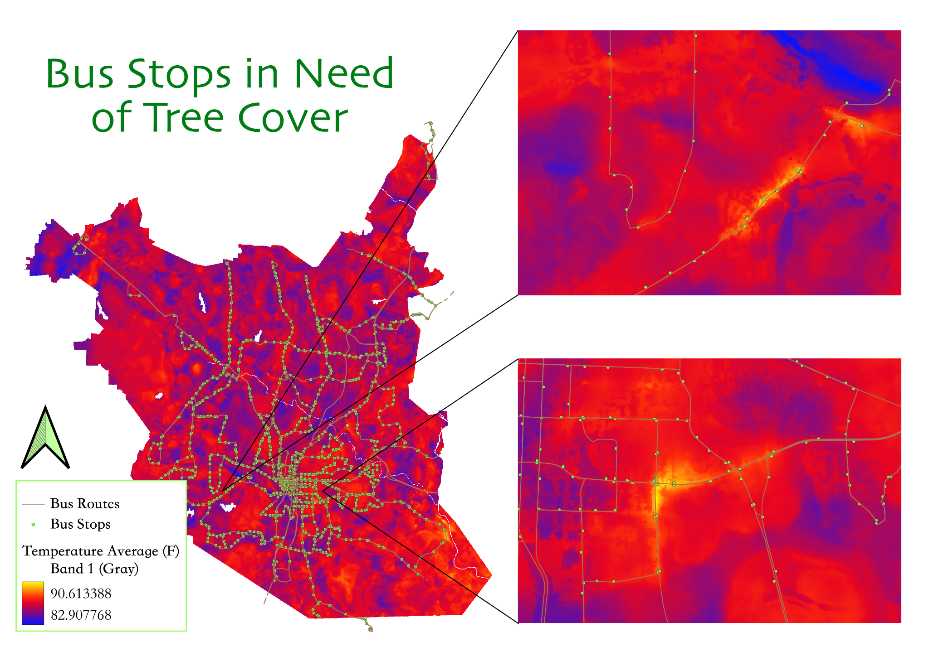

Slide 7
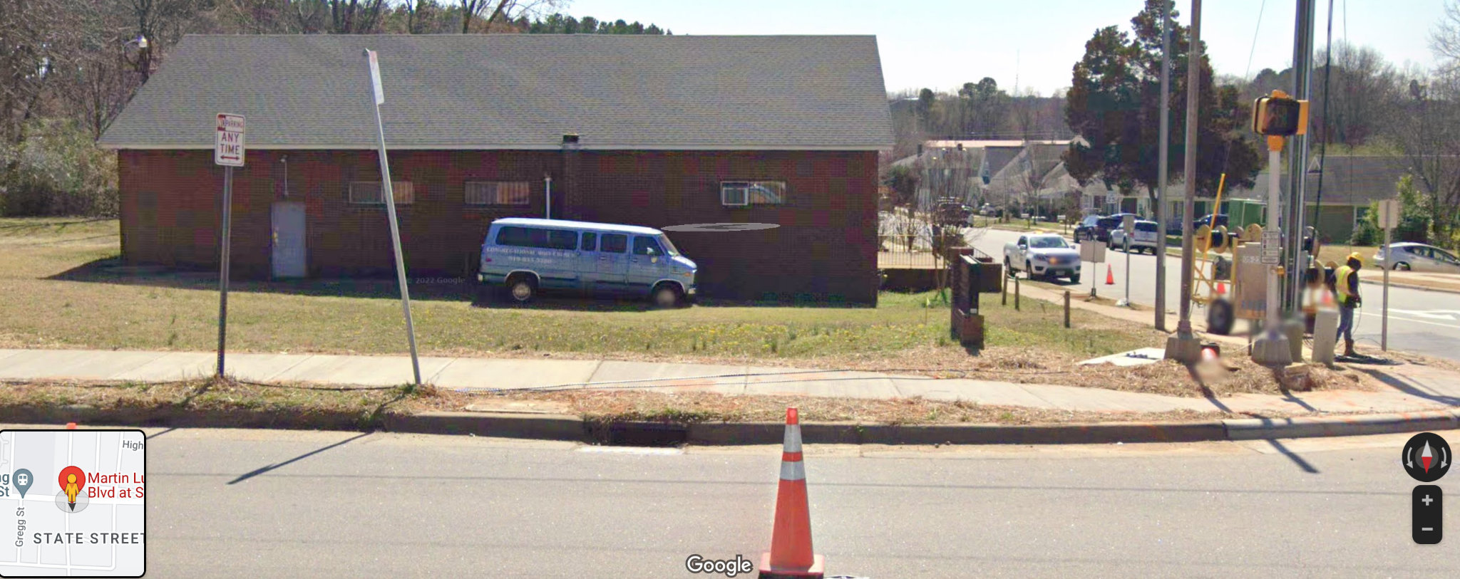
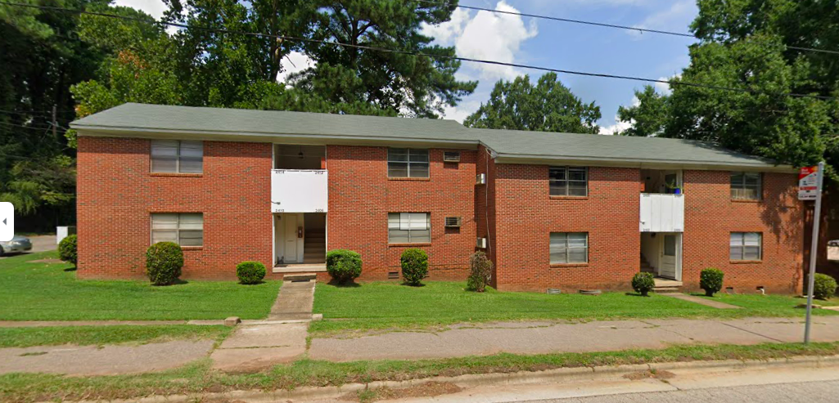

Slide 8
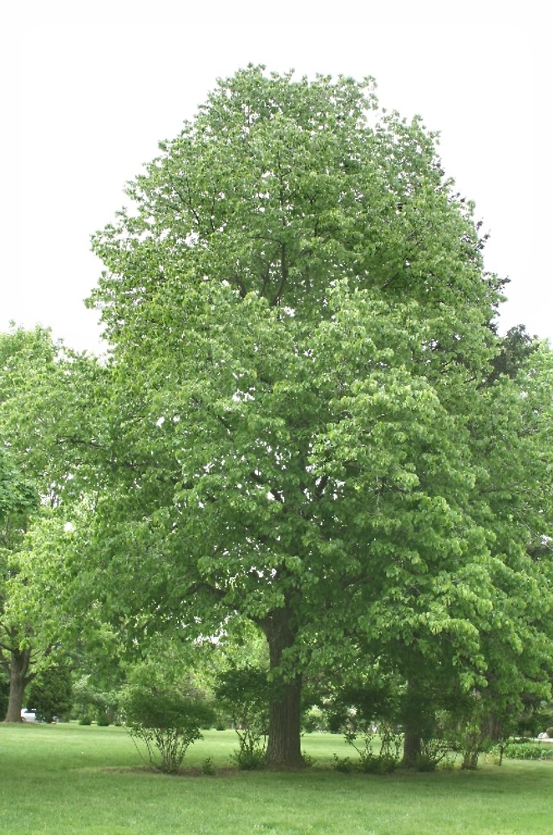
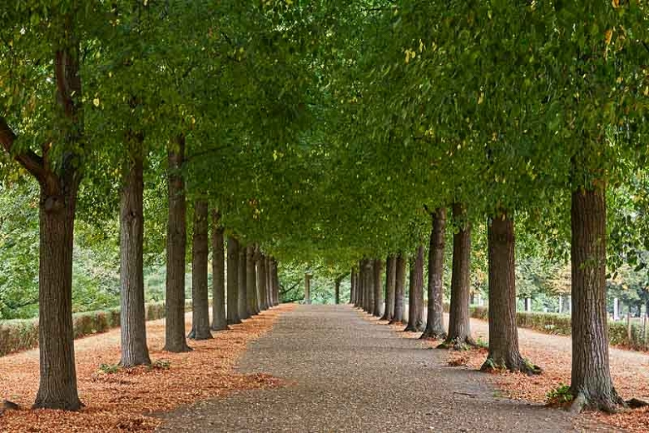
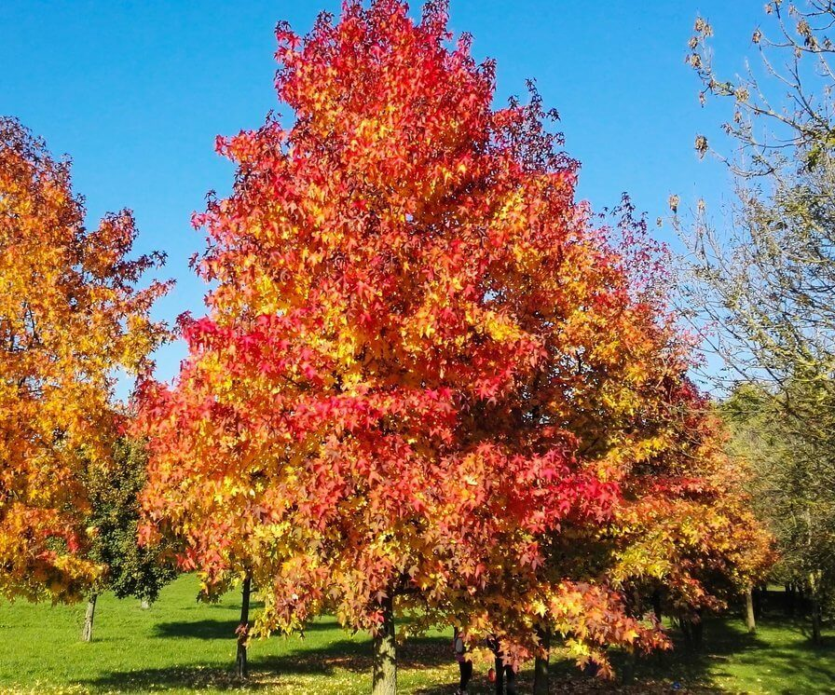
Proposed Tree Species To Plant
American Basswood
Quick Growth, Pollinator Friendly
30-50 ft Spread
Sweetgum
Quick Growth
20-50 ft Spread

Slide 9
Sources
“A Report on the Community Survey of Adults in Wake, Durham, and
Orange Counties North Carolina.” CJI Research, https://goforwardnc.org/wp-content/uploads/2020/08/Community-Survey-2019-Report-ver-4.pdf. Accessed 23 Apr. 2022.
“Heat Related Illness.” CDC,
https://www.cdc.gov/pictureofamerica/pdfs/picture_of_america_heat-related_illness.pdf. Accessed 23 Apr. 2022.
“Living Wage Calculator.” MIT, https://livingwage.mit.edu/counties/37183.
https://www.apexnc.org/DocumentCenter/View/467/Design-and-Development-Manual-PDF

Slide 10
Data Sources
https://climate.ncsu.edu/research/uhi/
https://data.wakegov.com/
https://github.com/datadrivenenvirolab/heat-hack-2022/tree/main/Data

